Slide 1

DELE CA1 Part B: Reccurent Neural Network
Name: IVAN TAY YUEN HENG
Class: DAAA/FT/2B/03

Slide 2
Part B Steps
Data preparation
Preprocess features
Remove null values
Remove duplicates
Increase data by translating
Change the classification
Tokenization
Train test split
3) Modelling
Base model
LSTM
GRU
4) Model Evaluation
Show accuracy
Classification matrix
Visualize model

Slide 3
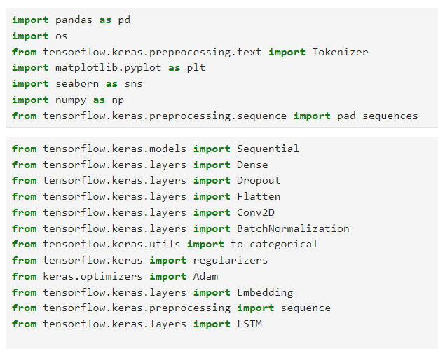
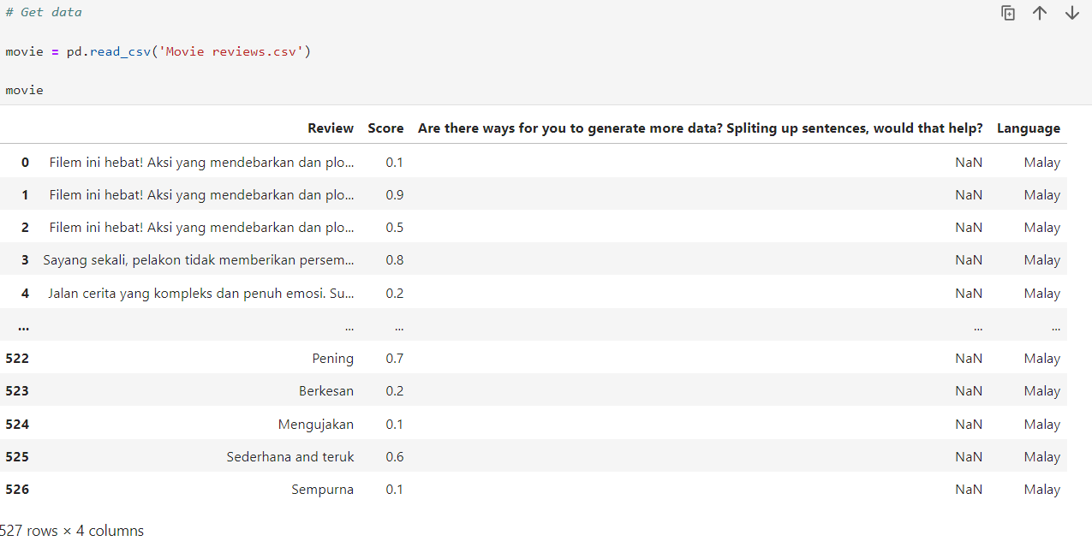
Data preparation
Import necessary modules.
Get movie data.

Slide 4
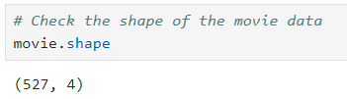
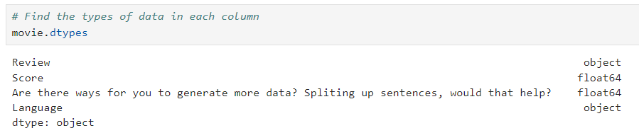
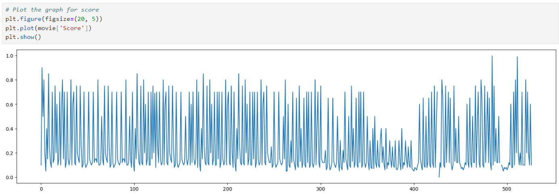
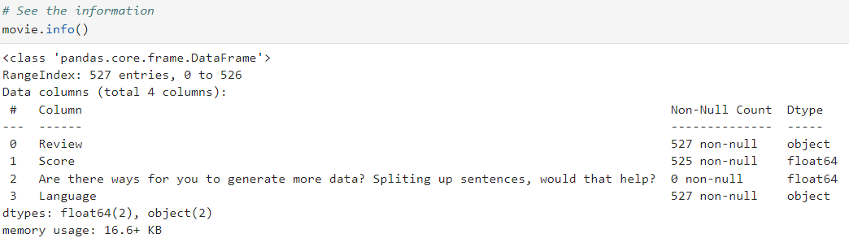
Data preparation
Check movie review shape which is 527 and 4.
Check movie review datatypes. For review and language, it is an object type. For other two columns is float64.
Check the movie review information.
Show the graph of the score. It is mostly between 0 and 1 in decimal points.

Slide 5
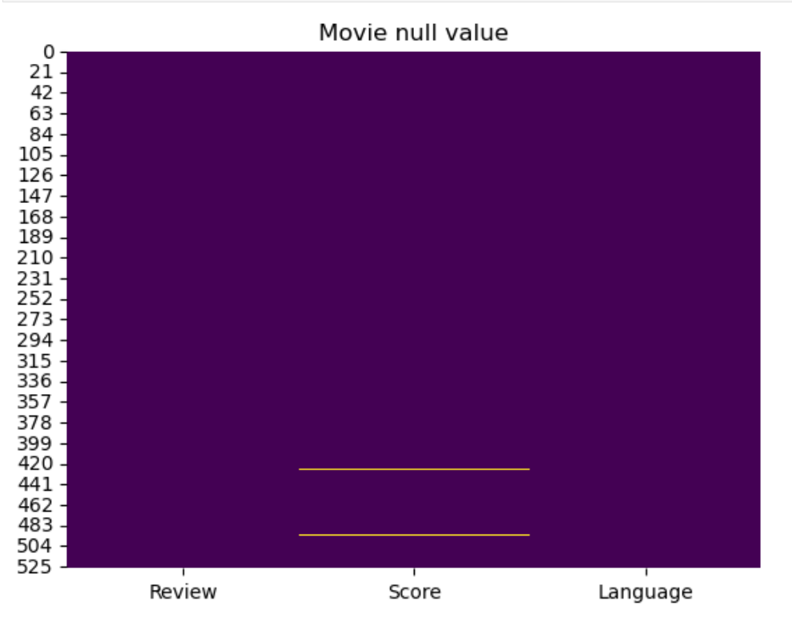
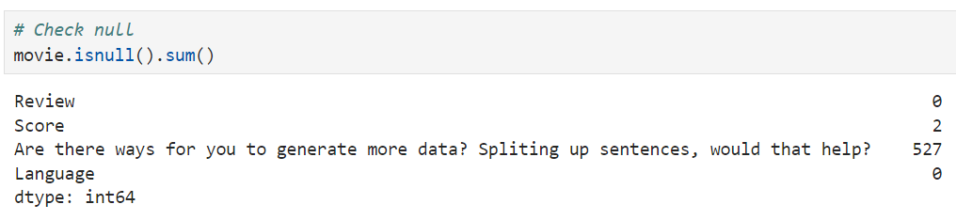
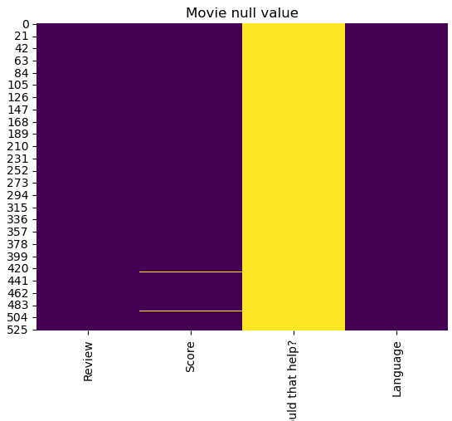
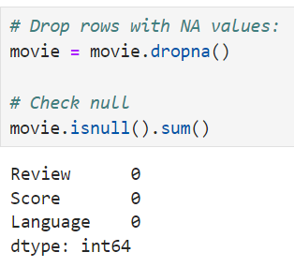
Preprocess features
There is still null value for score. Drop null value so there is no null value.
Since, "Are there ways for you to generate more data? Spliting up sentences, would that help?" does not help our data, I will drop it.

Slide 6
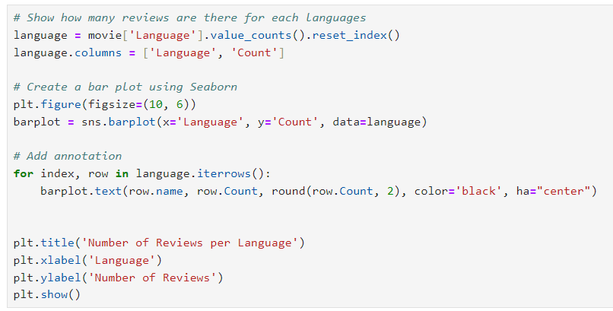

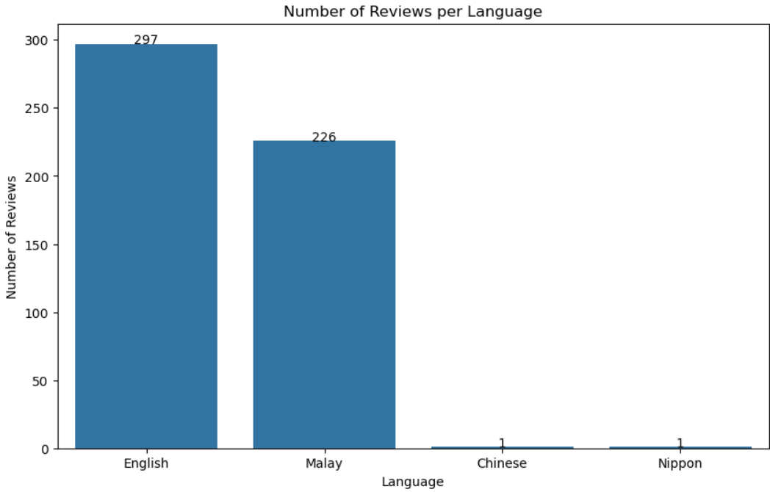
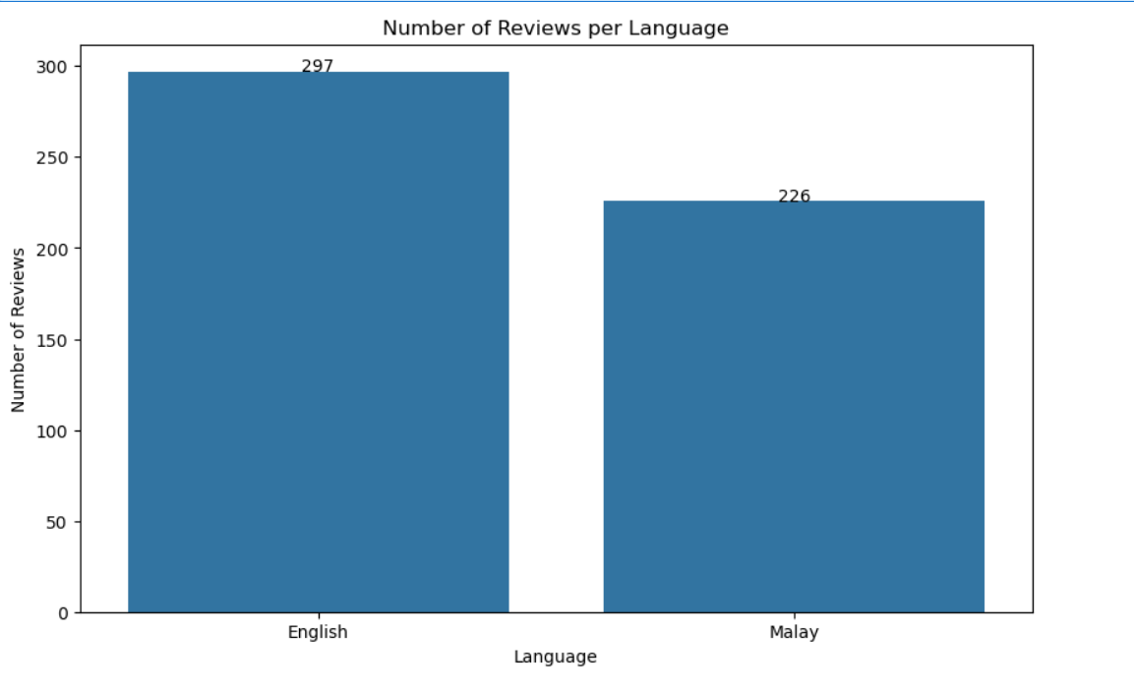
Drop language
We can see that Chinese and Nippon only have a total of 2 reviews. Since it does not contribute much to the data and training for the model, I decided to drop both those language.

Slide 7
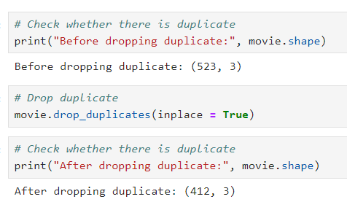
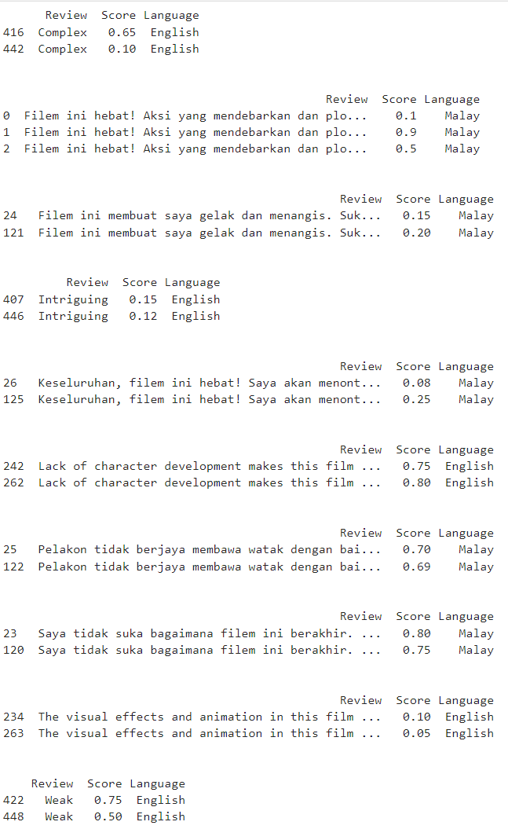
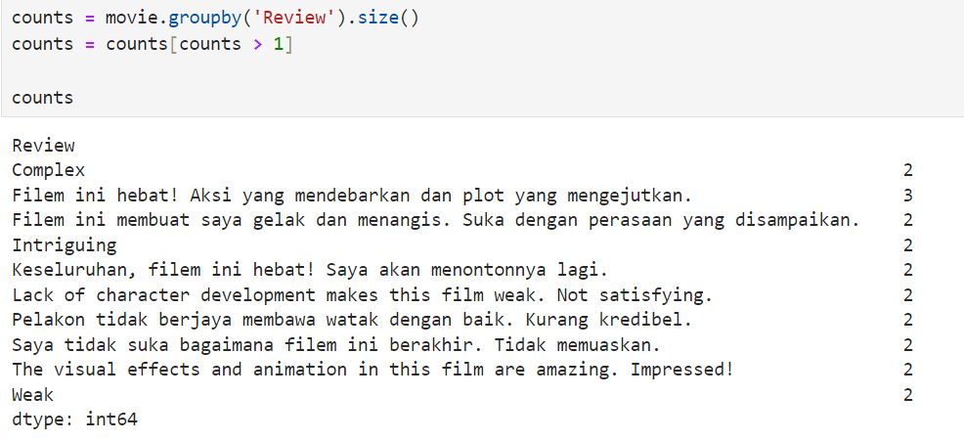

Remove duplicates
Manually remove data that does not align with the scores. Such as Complex should be a more negative review which is 0.65 but there is 0.1 for Complex.
Drop duplicates in the dataset. However, after dropping there is still some duplicates
Some reviews have duplicate but different scores. We want to manually remove those duplicates.
Drop duplicates of reviews that does not align well with the score.

Slide 8
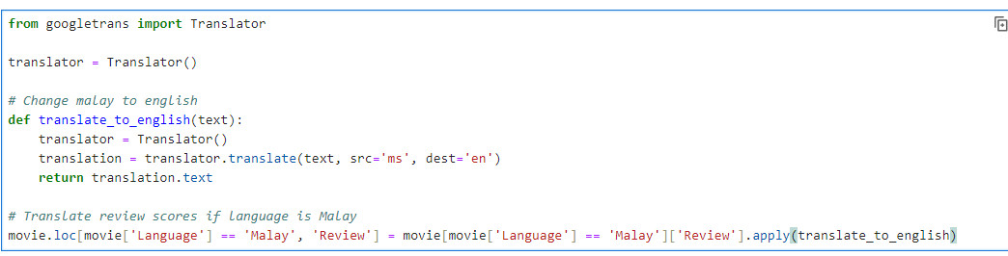
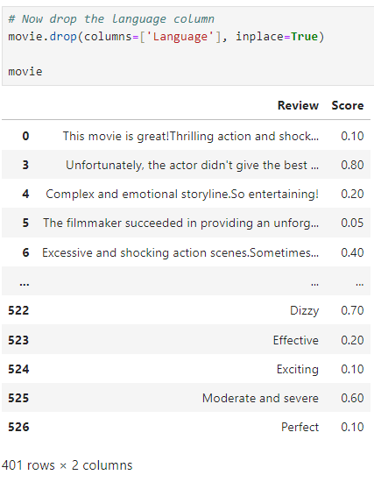
Translation to produce more data
Translate all Malay Language in the review score to English Language. This help produce more data because rather than splitting two data for two model. We have one model which predict English language.
After translating, drop the column language since all the reviews is in English.

Slide 9
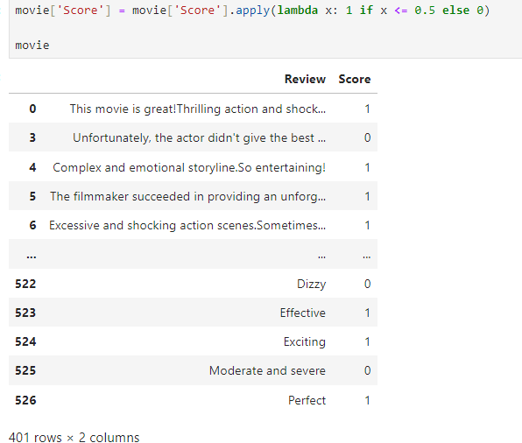
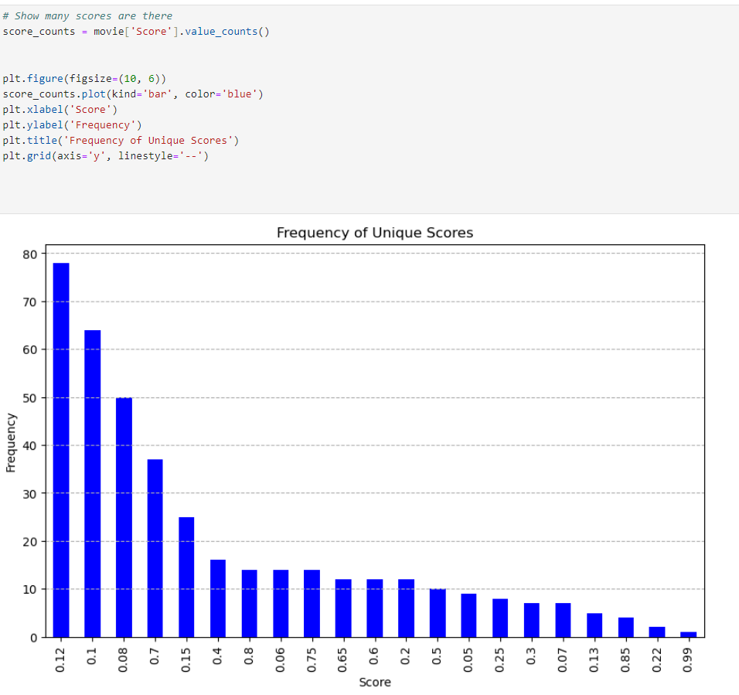
Preprocess data to allow classification
I decide to do classification. Since, the data is limited, classification would give a higher accuracy for model compared to using regression. Thus, we will use classification to do our model. I decide to change score to 0 and 1. 0 is negative and 1 is positive. Since the lesser the score the higher the positivity. We change that lesser than 0.5 for scores is positive and higher than 0.5 is negative.
The highest and second highest score are 0.12 and 0.1. This shows that there is more positive reviews then negative.

Slide 10
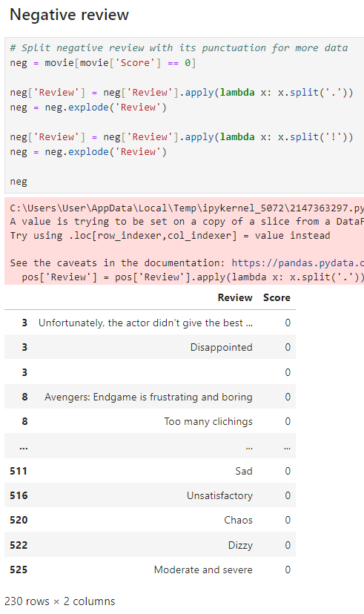
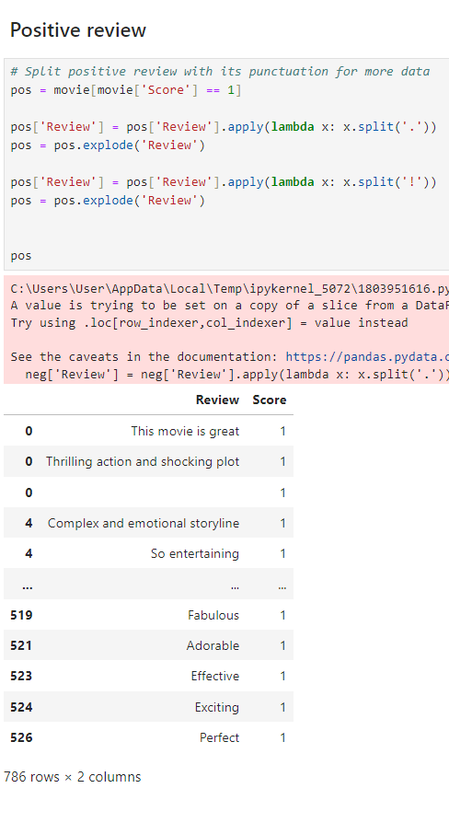
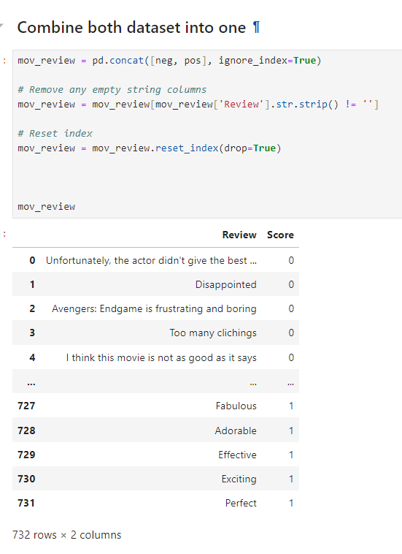
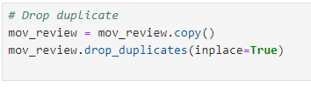
Produce more data by splitting punctuation
We want to split the data through punctuation to increase data to allow our model to train.
Split the positive and negative review through punctuation for more data.
Combine both dataset into one then remove empty string columns. Then, drop duplicates again

Slide 11
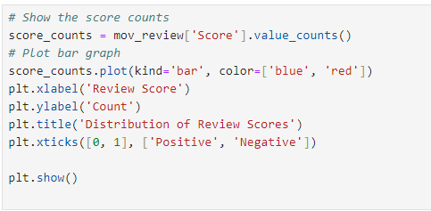
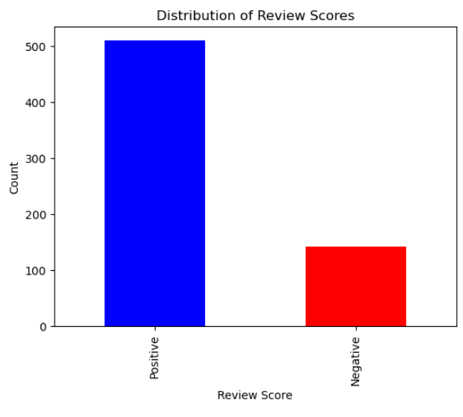
Visualisation
We can see that there is way more positive reviews then negative reviews

Slide 12
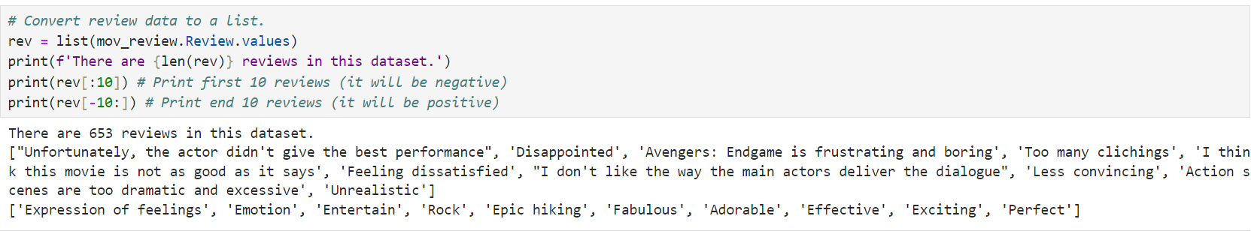
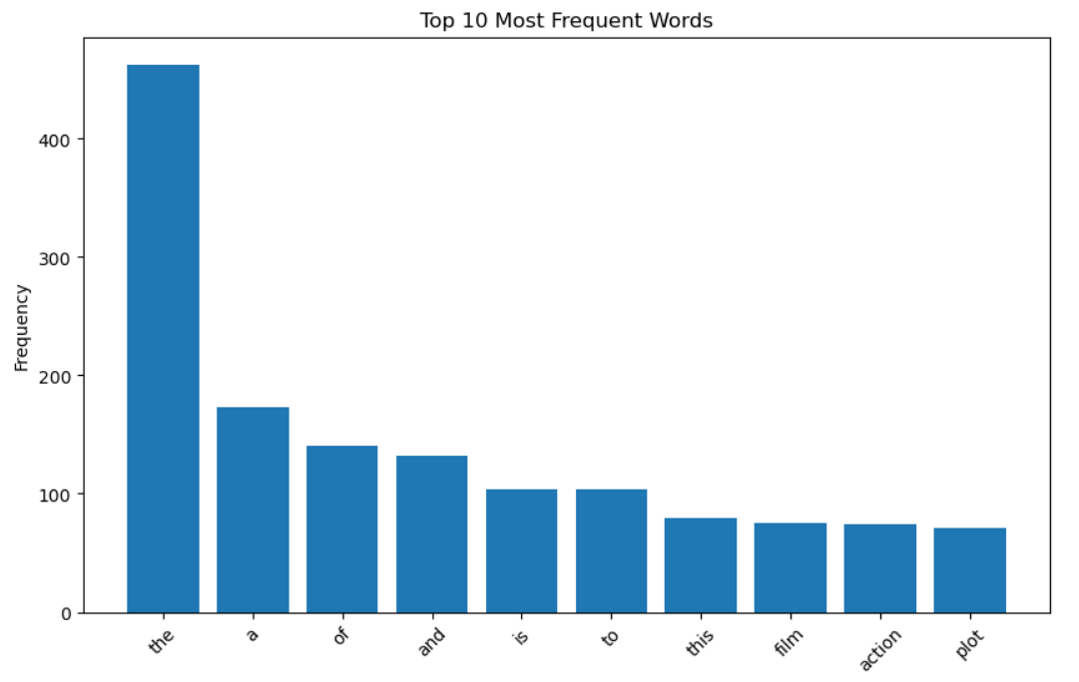
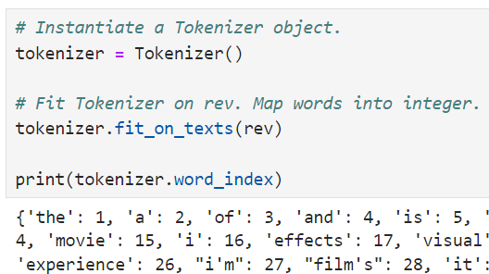
Tokenization
Convert review data to a list. Show first 10 reviews and end 10 reviews
Tokenize on the review data to map word into integer.
Show which words are more frequent in the dataset. We can see that “the”, “a”, and “of” are the three most frequent words.

Slide 13
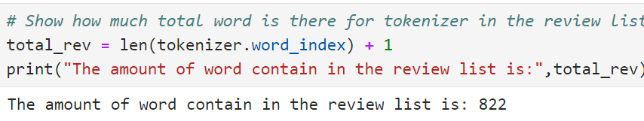
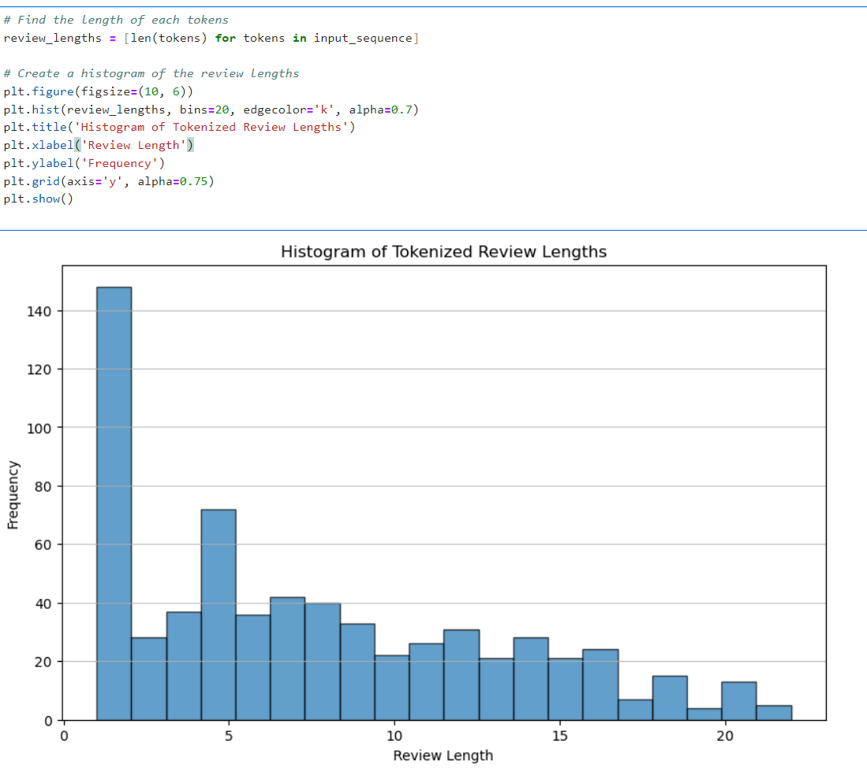
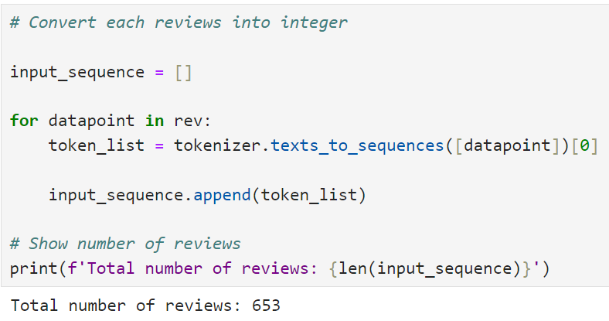
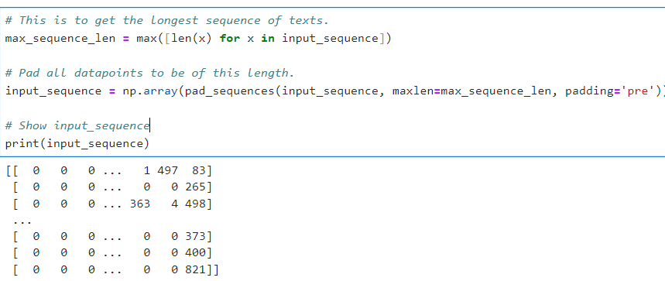
Convert review into integer
Show amount of word contain the review list which is 822.
Total number of reviews is 653 reviews.
We can see that most tokenized reviews lengths are between 0 and 5. The histogram shows a positively skewed diagram.
Do padding for the input_sequence.

Slide 14
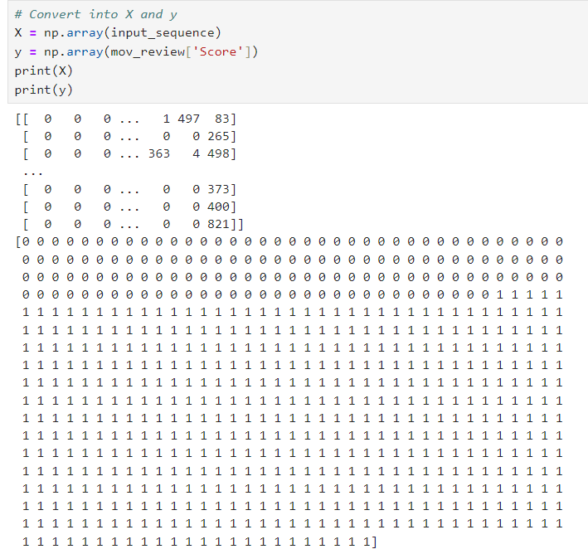
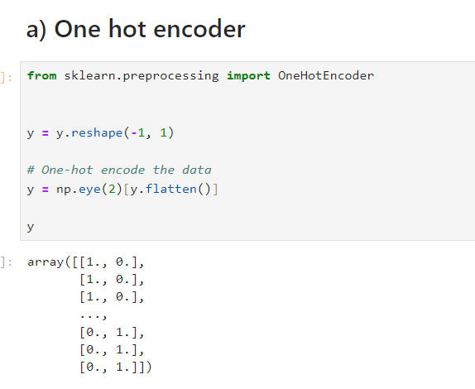
Convert data into X and y
Convert data into X and y. X is the tokenized reviews while
y is the movie review score.
Next, one hot encode y so it could be easily understood by the model later.

Slide 15
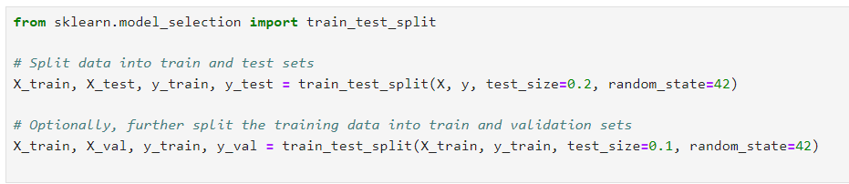
Train Test Split
Number of samples and labels in training set: 469
Number of samples and labels in validation set: 53
Number of samples and labels in testing set: 131

Slide 16
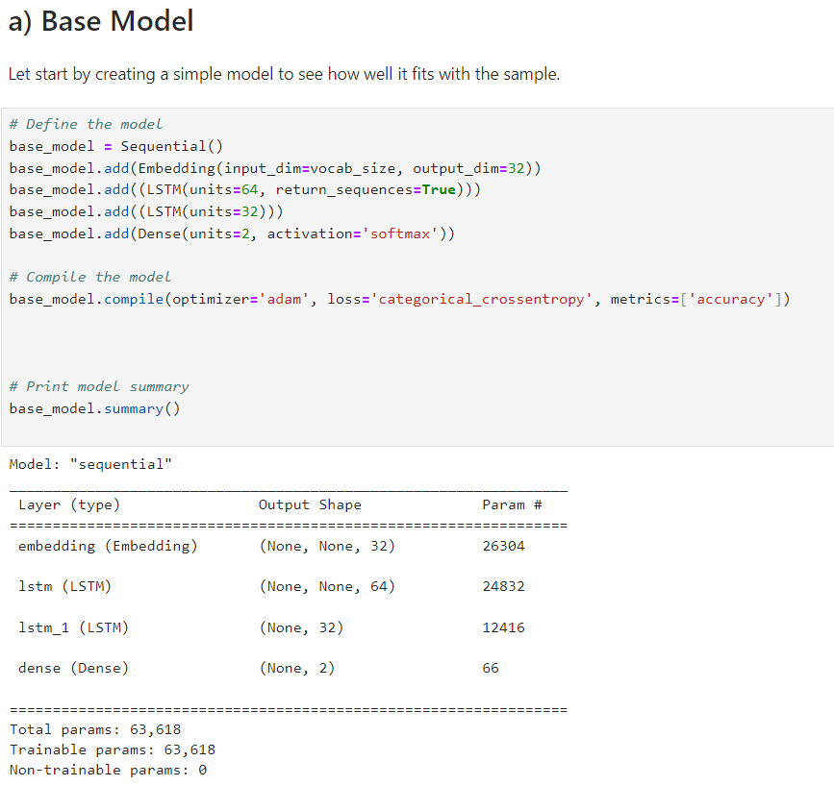
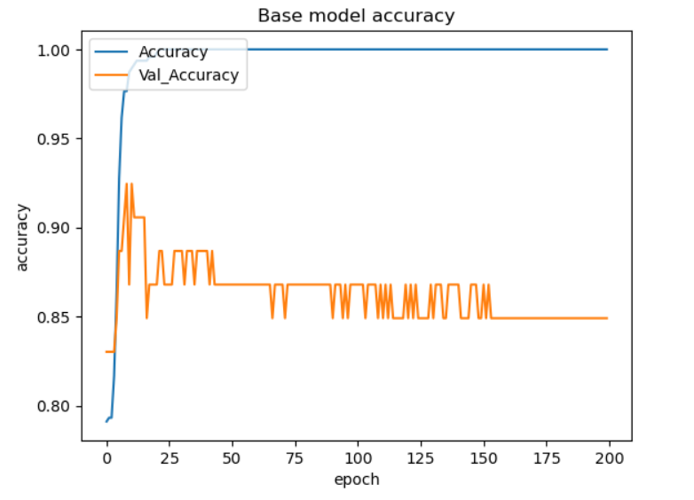
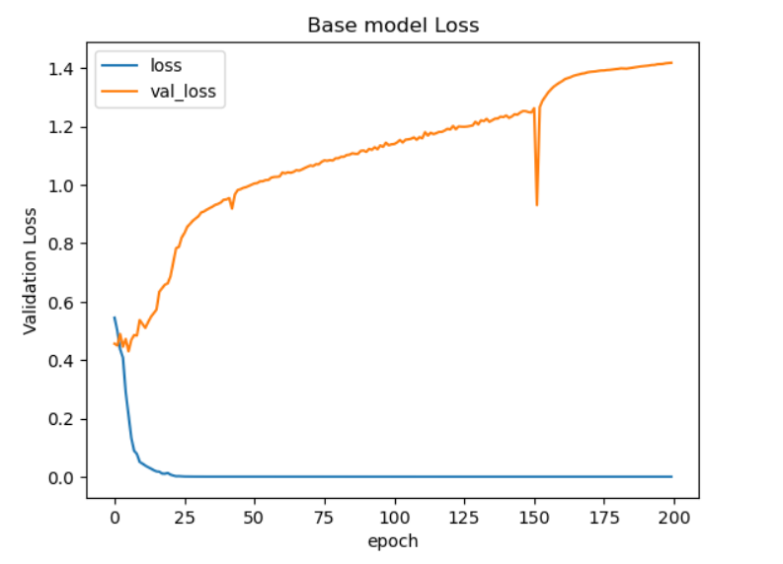
Base Model
Train the base history.
Create a simple Model with LSTM to see how well it fits with the sample.
The val_accuracy decreases over time while the val_loss increases overtime. There is a big overfitting problem. Thus, we need to hypertune the model.

Slide 17
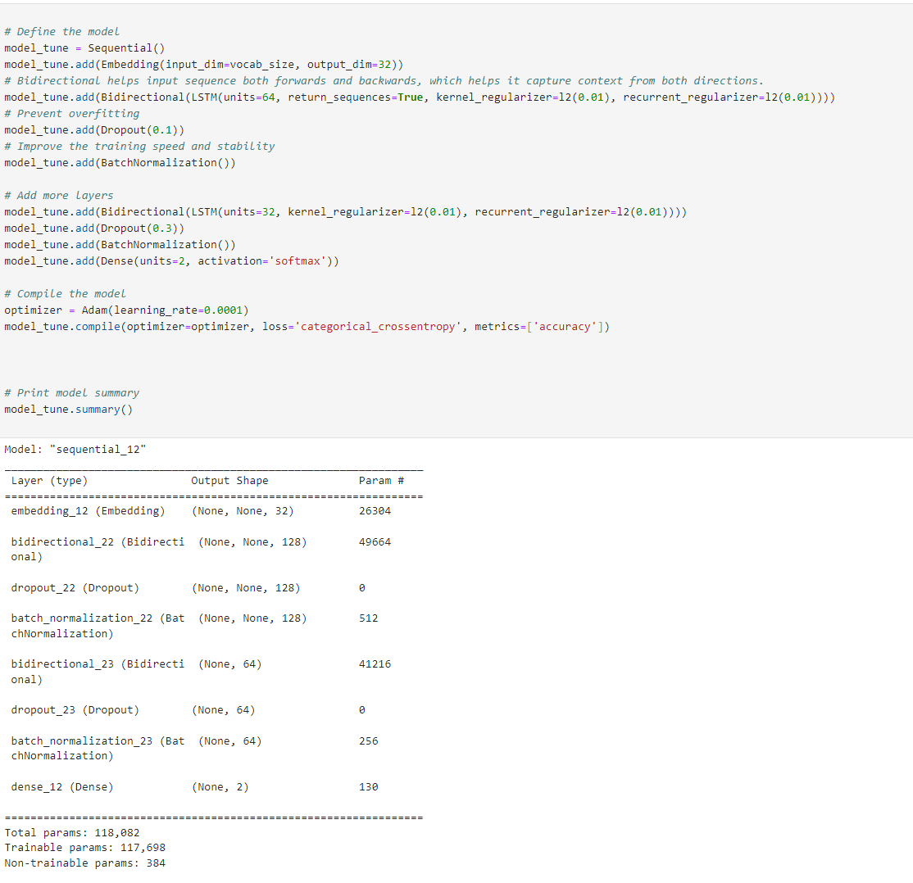
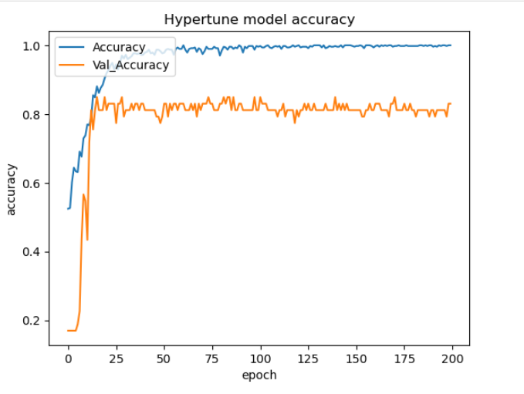
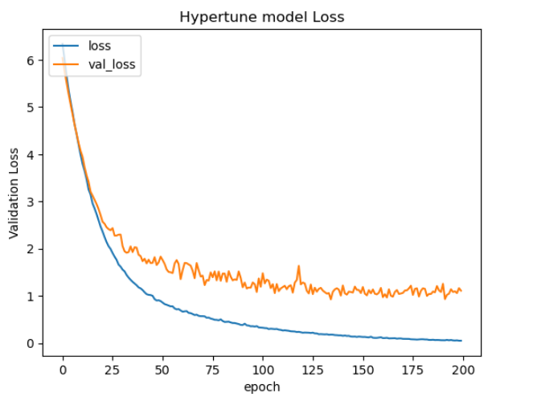
# Hyperparameter tuning model (Model Improvement) (LSTM)
The val_accuracy is high and val_loss is low while both is not overfitting as much as before. Thus, we could use LSTM but I decided to try using another RNN which is GRU.
I decide to add Bidirectional to help input sequence both forwards and backwards. Add dropout to prevent overfitting and add BatchNormalization to improve training stability. Kernel_regularizer and recurrent_regularizer is added to prevent overfitting too.

Slide 18
Hyperparameter tuning model (Model Improvement) (LSTM)
The val_accuracy is high and val_loss is low while both is not overfitting as much as before. Thus, we could use LSTM but I decided to try using another RNN which is GRU.
I decide to add Bidirectional to help input sequence both forwards and backwards. Add dropout to prevent overfitting and add BatchNormalization to improve training stability

Slide 19
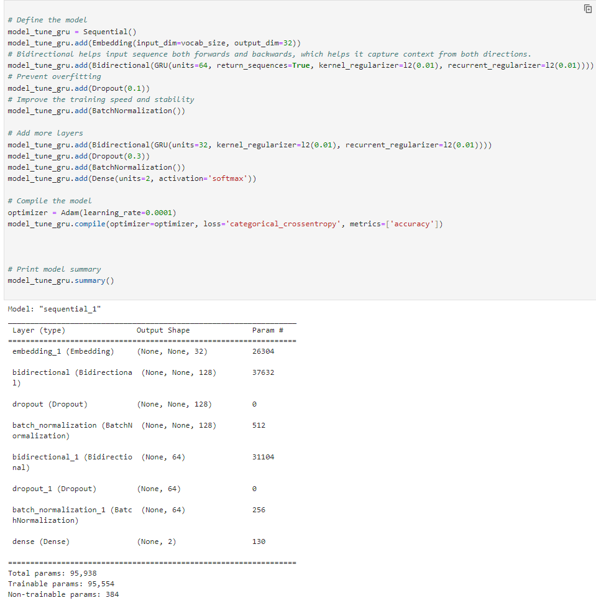
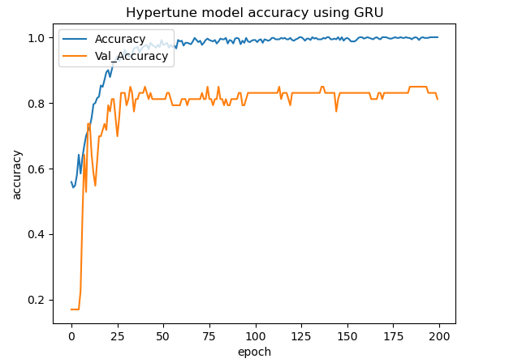
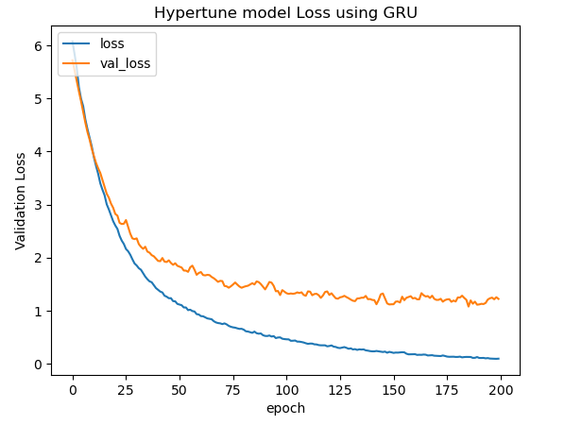
Hyperparameter tuning model (Model Improvement) (GRU)
The val_accuracy is high and val_loss is low while both is not overfitting as much as before. It has similar results to LSTM. Thus, we will check which model have the highest accuracy to determine the best model.
We will use GRU (Gated Recurrent Unit) model to see whether it help for our sequence model

Slide 20
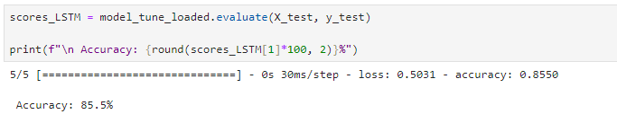
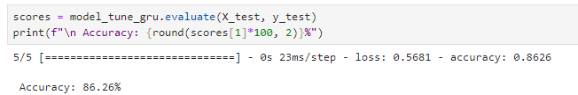
Find best model
LSTM
GRU
GRU has a higher accuracy than LSTM. Thus, GRU hypertune model is the best.

Slide 21

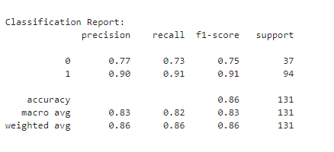
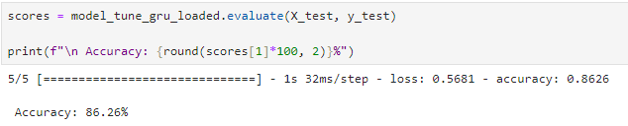
Model Evaluation for GRU
Save the model and save the model weights
GRU model have a 0.75 f1-score for predicting negative review but a 0.91 f1-score for predicting positive review.
GRU model have a 86.26% accuracy for prediction.

Slide 22
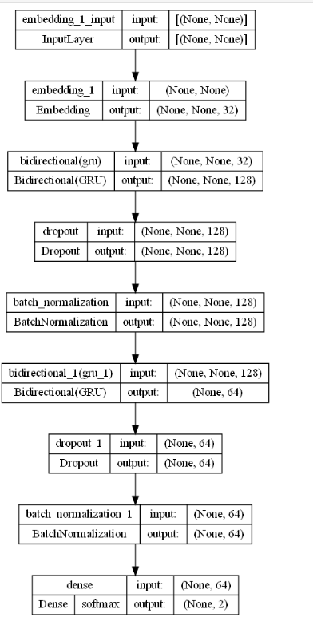
Model Evaluation for GRU
Visualise model →

